Slide 1
Introduction to Computer System Security
Systems III – 420-E31
Reference: http://www.sans.org/top-cyber-security-risks/
http://www.sfisaca.org/events/conference06/Presentations/S13.pdf

Slide 2
Overview
Components of Computer Security
Types of Cyber-Attacks
Web Application Vulnerabilities
Security Design Implications
Security in the SDLC
Notes:
Throughout discussion on security, I find it handy to come back to the analogy of money (a thing of value, analogous to data) and ways to protect it.

Slide 3
What is Computer Security
Process of preventing and detecting unauthorized use of your computer
Prevention helps stop intruders
Detection provides information if someone tries to get in
Could also involve response to attacks

Slide 4
Types of Information Risks
Confidentiality
Information should be available only to those who rightfully have access to it
Integrity
Information should be modified only by those who are authorized to do so
Availability
Information should be accessible to those who need it when they need it

Slide 5
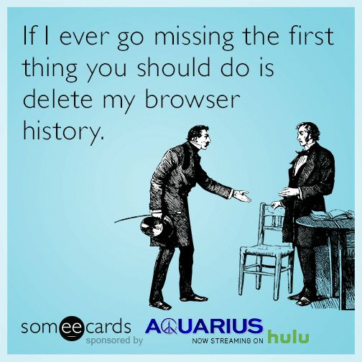
Sidebar: Privacy vs Confidentiality
Notes:
Why is this funny?
Because it has elements of truth in it. The need for privacy and confidentiality.

Slide 6
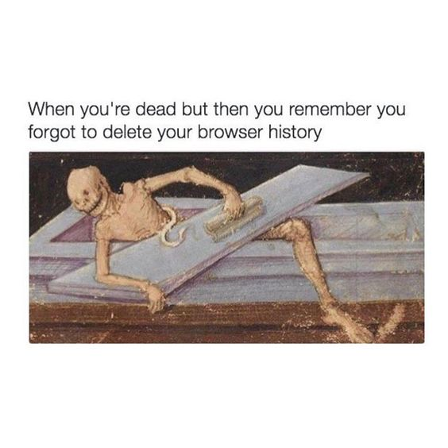
Sidebar: Privacy vs Confidentiality
Notes:
Why is this funny?
Because it has elements of truth in it. The need for privacy and confidentiality.

Slide 7
Sidebar: Privacy vs Confidentiality
Privacy
Applies to person
How a person is identified
The minimum amount of data required to conduct business
Confidentiality
Applies to data
An extension of privacy
What procedures will be put in place to ensure that only authorized individuals have access

Slide 8
Physical Risks
Disk failure
Affects availability, but is also a part of securing your data
Power failure/surge
Can cause physical damage to your computer
Physical Theft
Confidentiality, availability problems
Maybe integrity problems if recovered

Slide 9
People Risks
External
Steal company secrets
Reveal company plans
Destroy/delete
Internal
Even more implications because they are inside firewall
Downsizing
Angry at co-workers/boss/management
Can be accidental or on purpose

Slide 10
Other Risks
Using your computer to launch attacks
Denial of Service attacks on company
Erasing key files
Compromising files (changing content)
Extracting passwords
Extracting financial information

Slide 11
Top Security Risks
Unpatched Client-side software
New vulnerabilities found all the time
Vendor release patches to fix them
Office, Flash, QuickTime
Internet-facing web sites that are vulnerable
>60% of attacks on Internet are against web applications
Convert trusted site into malicious site
Sometimes use similar site name to business site
Reference: http://www.sans.org/top-cyber-security-risks/summary.php

Slide 12
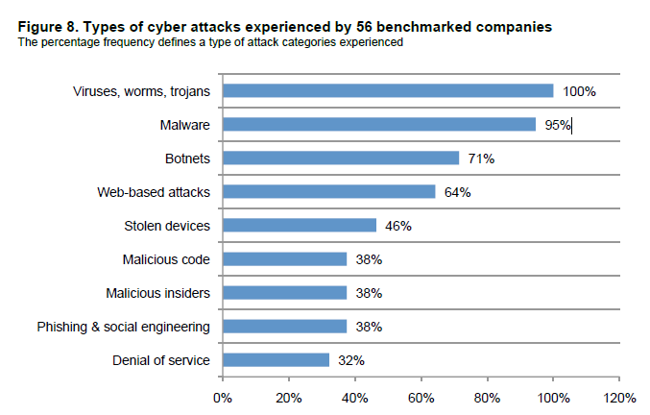
Types of Cyber Attacks in Practice
Notes:
Ref: Ponemon Institute, 2012 Cost of Cyber Crime Study: United States

Slide 13
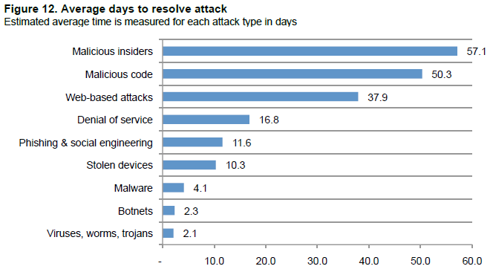
Time to Resolve Attacks
Notes:
Ref: Ponemon Institute, 2012 Cost of Cyber Crime Study: United States

Slide 14
Famous Worms
Morris Worm (1988)
Released into the wild on November 2, 1988, the Morris Worm was originally made in order to gauge the size of the Internet. However, a coding flaw in the program has inadvertently turned it into an extremely damaging, resource-hogging program capable of bogging down a computer system by infecting it multiple times.
ILOVEYOU (2000)
Also known as the Love Bug Worm and the VBS/Loveletter, the extremely harmful ILOVEYOU worm was able to spread like wildfire in 2000 because of its abilities to access the email addresses found in a user's Outlook contact list and send itself infinitely across the worldwide web while overwriting a victim's files.

Slide 15
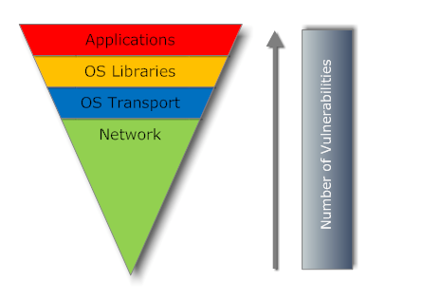
Exploitation Trends
Vulnerabilities in applications far greater than vulnerabilities in operating systems
More exploitation at application level

Slide 16
Security Vulnerabilities
This is your developed application.
This is all the stuff that your application was supposed to do, but doesn’t do. These are functionality bugs
This is all the stuff that your application is supposed to do.
This is all the stuff that your application CAN also do, but you’re not aware of. These are security vulnerabilities
This is your application design.
Source: http://www.sfisaca.org/events/conference06/Presentations/S13.pdf

Slide 17
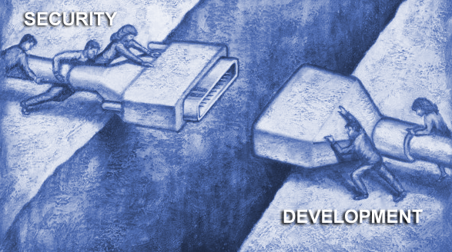
Why Web Application Attacks Occur
The Web Application
Security Gap
Security Professionals Don’t Know The Applications
Application Developers and QA Professionals Don’t Know Security
“As a Network Security Professional, I don’t know how my company’s web applications are supposed to work so I deploy a protective solution…but don’t know if it’s protecting what it’s supposed to.”
“As an Application Developer, I can build great features and functions while meeting deadlines, but I don’t know how to develop my web application with security in mind.”
Source: http://www.sfisaca.org/events/conference06/Presentations/S13.pdf
Notes:
Main Speaking Points:
There is a lack of awareness of application vulnerabilities in security departments.
Even in departments that want to audit for web application vulnerabilities, the lack of effective tools has made it impractical
As a result, Certification and Accreditation programs rarely examine the web application
In fact, the entire development cycle is usually missing from security procedures and controls
Security Departments scrutinize the desktop, the network, and even the web servers, but the web application escapes their measures.
This illustrates the fundamental gap between security and development, which creates these web application vulnerabilities

Slide 18
Web Application Attacks
Brute force password guessing
Microsoft SQL, FTP, and SSH servers are popular targets
The access that is gained if a valid username/password pair is identified is large
Web Application Attacks
SQL Injection, Cross-site Scripting and PHP File Include attacks
Use automated tools to target custom web vulnerabilities

Slide 19
Zero Day Vulnerability
Flaw in software code is discovered and code exploiting the flaw appears before a fix or patch is available
Vulnerabilities are often found in 3rd party add-ons to popular and wide-spread software suites like Office and Flash
One of the most significant threats
Can go for as high as $1,500,000 each on black market
Notes:
Show cirt.net/passwords – show Apple computer and Oracle
Source: http://www.sans.org/top-cyber-security-risks/

Slide 20
Stuxnet (2005? -2010)
Stuxnet is a malicious computer worm, first uncovered in 2010 by Kaspersky Labs, the antivirus company.
Thought to have been in development since at least 2005, stuxnet targets SCADA systems and was responsible for causing substantial damage to Iran's nuclear program.
Stuxnet attacked Windows systems using an unprecedented four zero-day attacks
Country Share of infected computers
Iran 58.85%
Indonesia 18.22%
India 8.31%
Azerbaijan 2.57%
United States 1.56%
Pakistan 1.28%
Other countries 9.2%

Slide 21
Implications to Design
Hardware
Router/Modem
Firewall
Physical Space
Printers and Output
Software
Operating System
Patches
Updates
Other software not related to your system

Slide 22
Implications to Design
Development
Programming Environment
Database
Third party tools
Testing
Exposure
Privacy of data (obfuscation)
Third party users/testers
Notes:
Vulnerabilities
Patches

Slide 23
Implications to Design
Installation
Data migration
Patch levels
Other software
Port opening/exposure of web sites
Operations and Maintenance
Maintaining patch level
Up-to-date virus software
New hardware/software implications
Backup and Recovery

Slide 24
Implications to Design
Project Management
Protecting assets
Communication of details and privacy
External personnel attacks
Internal personnel attacks
Network
What ports to open
Firewall Setup
Availability

Slide 25
Implications to Design
Physical Space
Printers and confidentiality
Protection of hardware
Climate control
Location
Transportation of information
Backup media
Disaster Recovery (DR)

Slide 26
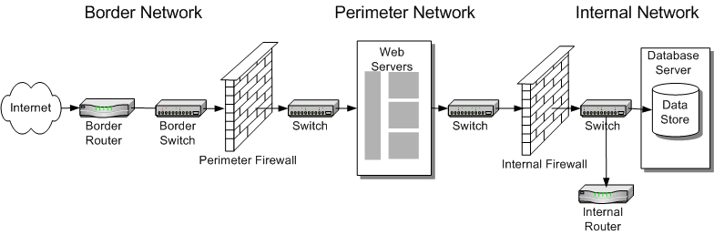
Implications to Design
Notes:
Multi-tier, multi-firewall
Analogy: There’s not just one door to the outside world in a bank. There’s layers

Slide 27
Implications to Design
Application Design
Exposure on Internet
Authentication
Authorization
Database vulnerabilities
SSL or not
SQL injections
Interfaces to other systems
Timeouts on accounts
Notes:
Keeping plain text passwords in databases

Slide 28
Enterprise-Wide Web Application Security
Web Application Security testing must be applied in all phases of the Application Lifecycle and by all constituencies throughout the enterprise – Auditors, Application Developers, QA and Security Operations.
A
D
A
D
Web
Web
Web
Web
Application
Application
Application
Application
Security
Security
Security
Security
Q
S
Q
S

Slide 29
Enterprise-Wide Web Application Security
D
D
Application Developers
Must have clear cut security requirement to follow during Development and QA phases
Need to run automated tests on code during Development phase
Must utilize secure code for re-use
Require automated testing products that integrate into current environment
A
A
Web
Web
Web
Web
Application
Application
Application
Security
Security
S
Q
S
Q

Slide 30
Enterprise-Wide Web Application Security
Quality Assurance Professionals
Must test applications not only for functionality but also for security
Must test environments for potential flaws and insecurities
Must provide detailed security flaw reports to development
Require automated testing products that integrate into current environment
D
A
D
A
Web
Web
Web
Web
Application
Application
Application
Security
Security
S
S
Q
Q

Slide 31
Enterprise-Wide Web Application Security
Security Operations
Must continually test application in a real world environment to asses impact of ongoing code changes
Must look for all levels of web vulnerabilities
Platform
Informational
Application
D
A
D
A
Web
Web
Web
Web
Application
Application
Application
Security
Security
Q
Q
S
S
Security

Slide 32
Enterprise-Wide Web Application Security
Security Auditors and Risk
and Compliance Officers
Help define regulatory requirements during the Definition phase of the Application Lifecycle
Assess applications once they are in the Production phase to validate compliance
Must act as resource for what is and is not acceptable
A
D
D
Web
Web
Web
Web
Application
Application
Application
Security
Security
S
Q
S
Q

Slide 33
Terms to Research
Parameter Manipulation
Cross-Site Scripting
SQL Injection
Buffer Overflow
Reverse Directory Transversal
Path Truncation
Cookie Manipulation
Directory Enumeration
Notes:
Class activity and presentation.

Slide 34
Your Results
Reverse Directory Transversal – Access to restricted directories by blindly guessing the URL path.
Path Truncation – Taking out the file name in a URL to get the directory listing of that URL.
Cookie Manipulation – Reading and/or changing values stored in a cookie.
Directory Enumeration – Accessing the directories and filenames stored in a website.

Slide 35
Your Results
Parameter Manipulation – manipulation of parameter data exchanged between client and server in order to modify app info.
Cross-Site Scripting – the injection of client side script into web applications used by other users
SQL Injection – placing malicious SQL code in a field, etc. with the intent of changing some part of the internal data.
Buffer Overflow – an attack that uses the buffer of an application to write outside the bounds of what the application is supposed to access.

